Slide 1

18 Months Too Long
Ireland HSE Waiting List Analytics 2018–2021
Nallabothula Pavan Kumar
EXPLORATORY DATA ANALYSIS
PYTHON
SQL
INTERACTIVE DASHBOARD
NPK05

Slide 2

Agenda: A Data-Driven Journey
Through Ireland's Healthcare Crisis
01
Business Problem
02
Dataset Overview
03
Key Metrics at a Glance
04
Volume & Trends
05
COVID-19 Impact Analysis
06
Specialty Risk Analysis
07
Demographics
08
Statistical Analysis
09
Recommendations
10
Conclusion & Contact
NPK05
02

Slide 3






Ireland's Healthcare System Faces a Structural Waiting Crisis
24.6M total patient-waits recorded · 4.58M waiting 18+ months (18.6%)
Chronic Backlog at Scale
Resource–Demand Mismatch
COVID-19 Surge Effect
Nearly 1 in 5 patients waited longer than 18 months, far exceeding acceptable clinical thresholds and international benchmarks.
Outpatient services carry 88.2% of the total patient-wait volume, yet inpatient capacity decisions dominate policy discussions.
The pandemic triggered a +121% surge in 18+ month inpatient waiters within just 12 months, compressing years of backlog growth.
Specialty Inequity
Absence of Early Warning
ENT, Eyes, and Urology specialties exhibit long-wait rates exceeding 20–32%, indicating that the bottleneck is capacity allocation.
Despite a statistically confirmed upward trend (Spearman ρ = 0.194), no automated monitoring mechanism existed to flag deterioration.
NPK05
03

Slide 4



Dataset: 452,944 Records Spanning Three Years of HSE Activity
Key Data Fields
SOURCE
Field Name
Description
HSE Open Data
data.gov.ie
Archive Date
Monthly snapshot date (Jan 2018 – Mar 2021)
Specialty
Clinical specialty (e.g., ENT, Orthopaedics)
Case Type
Inpatient or Outpatient classification
TOTAL RECORDS
452,944
Age Group
Adult or Child categorization
Jan 2018 – Mar 2021
Time Band
Waiting duration category (7 bands)
Total
Number of patients in that specific cohort
RECORD BREAKDOWN
Outpatient (OP)
59.8%
Time Bands
0–3 Months
3–6 Months
6–9 Months
9–12 Months
12–15 Months
15–18 Months
Inpatient (IP)
40.2%
18+ Months
NPK05
Data Quality Note: 191 records with missing HIPE codes were identified; analysis proceeds on complete records.
No patient-level linkage available.
04

Slide 5
Six KPIs Reveal the Scale and Severity of the Crisis
Key Metrics at a Glance — Ireland HSE Waiting Lists 2018–2021
TOTAL PATIENT-WAITS
WAITING 18+ MONTHS
OUTPATIENT SHARE
24.6M
4.58M
88.2%
Accumulated volume across all specialties (2018–2021)
18.6% of all patients waited longer than the 1.5 year threshold
Dominant case type by volume, driving the backlog
COVID SURGE (18+ MO IP)
HIGHEST LONG-WAIT RATE
TREND CONFIRMATION
+121%
32%
ρ=0.194
Inpatient long-waiters jumped from 5,105 to 11,306 in 12 months
ENT is the worst-performing specialty for delays
Spearman correlation confirms statistically significant deterioration
NPK05
05

Slide 6

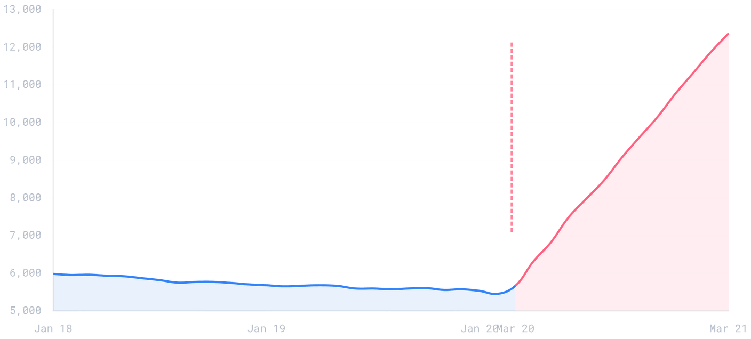
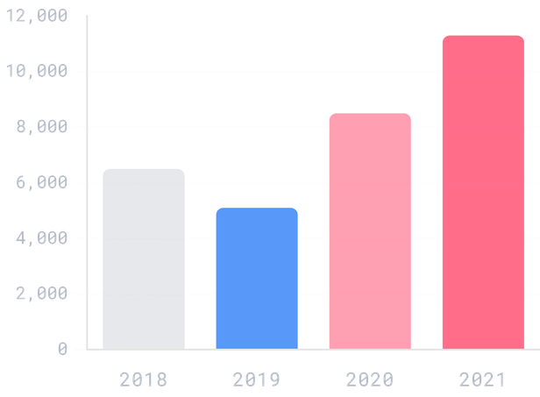
2019 Was the Last Year of Improvement Before COVID Reversed All Gains
Volume & Trends Analysis · 2018–2021
Annual Volume Context
Monthly 18+ Month Waiter Trend
COVID-19 Impact
2018: Baseline year with moderate volumes.
•
2019: Only year of improvement in 18+ month wait rates.
•
COVID SHOCK
2020: COVID-19 struck, elective services suspended.
•
2021: Backlog accelerating rapidly.
•
"2019 was the last year of improvement — COVID erased two years of progress in under 12 months."
NPK05
06

Slide 7



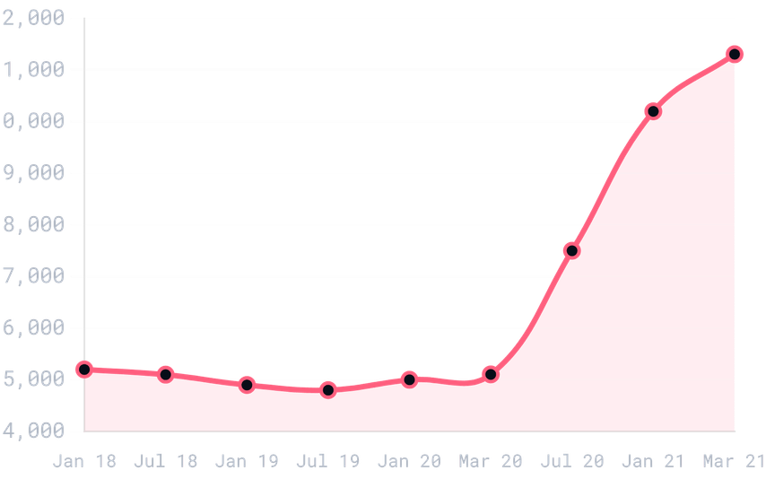

COVID-19 IMPACT ANALYSIS
COVID-19 Triggered a +121% Surge in the Most Vulnerable Wait Category
Pre-COVID vs. Post-COVID Impact
18+ Month Inpatient Waiters (2018–2021)
Metric
Feb 2020
Mar 2021
Change
Monthly 18+ Mo Inpatient Waiters
5,105
11,306
+121%
Total Active Waiters
~620K
~850K
+37%
18+ Month Share of All Waits
15%
22%
+7 pp
Elective Procedure Capacity
100%
~40%
−60%
Key Findings
Aging Backlog: The surge was not driven by new demand, but by existing patients aging into longer time bands while services were suspended.
•
Accelerating Crisis: The backlog was still accelerating at the March 2021 data cut-off, indicating the peak had not yet been reached.
•
Inpatient Hit Hardest: Inpatient services faced disproportionate disruption due to bed reallocation for COVID-19 care.
"2019 was the last year of improvement — COVID erased two years of progress in under 12 months."
•
CRITICAL INSIGHT · RECOVERY PLANNING ABSENT
NPK05
07

Slide 8

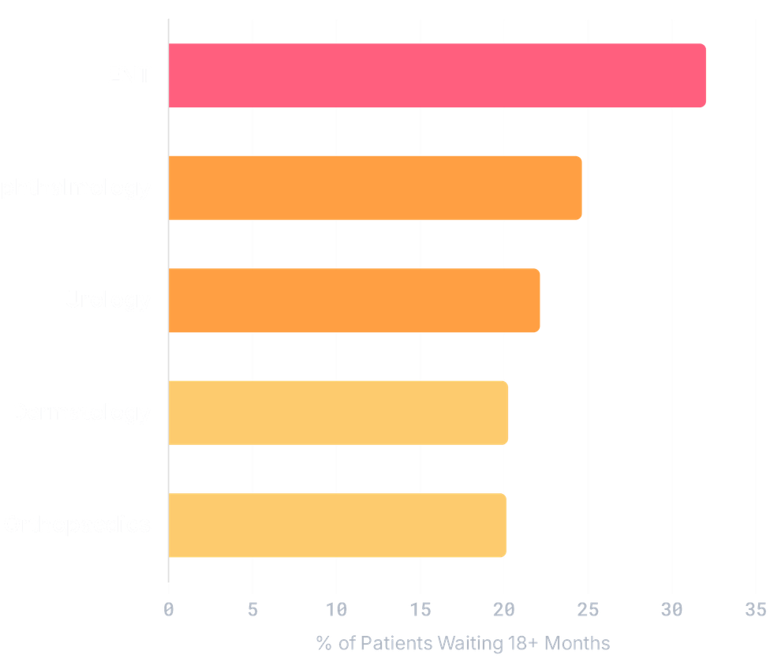
ENT, Eyes, and Urology Are Structural Bottlenecks
SPECIALTY RISK ANALYSIS
ENT (Ear, Nose & Throat)
CRITICAL · 32.0%
Disproportionate share of 18+ month waits. Highest long-wait rate indicates severe capacity failure.
Ophthalmology (Eyes)
HIGH · 24.6%
Significant clinical risk; delayed treatment can result in permanent vision loss.
Urology
HIGH · 22.1%
Cancer pathway concerns; many referrals are for suspected malignancy requiring urgent care.
KEY INSIGHT
"The bottleneck is capacity, not demand. These specialties do not have abnormally high volumes, but lack consultant availability."
NPK05
08

Slide 9
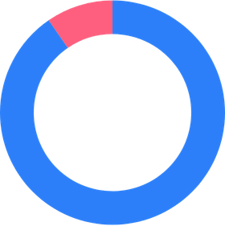
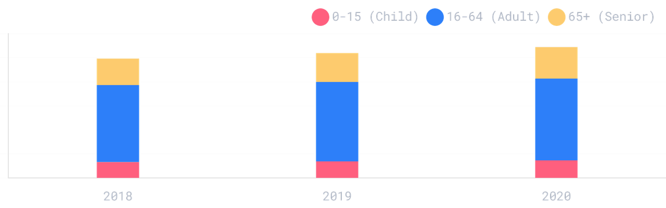
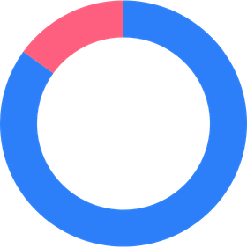
Children Carry a Disproportionate Outpatient Burden
DEMOGRAPHICS ANALYSIS · ADULT VS. CHILD DISTRIBUTION
Age Group Volume Trend (2018–2020)
Inpatient (IP)
Adult
90.4%
Child
9.6%
Outpatient (OP)
Adult
84.9%
Child
15.1%
Key Finding: Children represent 15.1% of outpatient waits but only 9.6% of inpatient waits. This suggests a "gatekeeping" effect where children are managed in outpatient settings for longer periods before accessing inpatient treatment.
Higher Child Share
+19%
Growth in 65+ Cohort over 2 years
NPK05
09

Slide 10


STATISTICAL ANALYSIS
Statistical Tests Confirm Significant Deterioration
Descriptive Statistics
Hypothesis Testing Results
Metric
Inpatient
Outpatient
Combined
Test
Statistic
p-value
Result
Mean
1,842
3,104
2,612
Kruskal-Wallis
H = 141.4
< 0.001
SIGNIFICANT
Median
892
1,547
1,203
Interpretation: Specialty distributions differ significantly
Mann-Whitney U
U-stat
≈ 0.000
SIGNIFICANT
Std Dev
2,891
4,203
3,712
Skewness
5.8
5.4
5.6
Interpretation: IP vs OP distributions are distinct
Chi-Square
χ² = 2015.7
< 0.001
WEAK ASSOC.
Kurtosis
42.1
38.7
40.3
Interpretation: Case type × time band association is weak (V=0.067)
CV%
157%
135%
142%
Spearman ρ
ρ = 0.194
0.001
TRENDING UP
Interpretation: Confirmed upward deterioration over time
Pearson r
r = 0.114
0.068
MARGINAL
Methodological Note: Non-parametric tests (Kruskal-Wallis, Mann-Whitney, Spearman) were selected due to high skewness (> 5.4) and non-normal distribution of waiting list counts.
Interpretation: Linear trend marginal; non-linear preferred
NPK05
10

Slide 11





Six Prioritised Actions to Break the 18-Month Barrier
RECOMMENDATIONS
CRITICAL PRIORITY
HIGH PRIORITY
OPERATIONAL
Declare National 18+ Month Emergency
COVID Backlog Recovery Plan
Realign Resources to Outpatient
Establish a dedicated taskforce with ministerial accountability. 4.58M patients waiting beyond 18 months requires an emergency-level response.
Implement a structured, specialty-specific clearance programme with monthly milestones. The +121% surge has no current recovery trajectory.
88.2% of the patient-wait burden is in outpatient settings. Capacity investment must shift from inpatient beds to outpatient clinics.
EQUITY FOCUS
MONITORING
DATA OPS
Ring-Fence Paediatric Capacity
Automated Monthly KPI Alerting
Fix Missing HIPE Codes & Linkage
Children represent 15.1% of OP waits but only 9.6% of IP slots. Dedicated pathways are needed to prevent developmental risks.
Deploy live dashboards with threshold alerts. Statistical deterioration (ρ=0.194) was detectable long before the crisis peaked.
Resolve the 191 missing codes and enable patient-level linkage. Current aggregate data limits causal analysis and pathway mapping.
NPK05
11

Slide 12


“ Behind every number is a patient
waiting in pain. ”
Nallabothula Pavan Kumar
npavankumarus72@gmail.com
linkedin.com/in/nallabothulapavankumar
PYTHON
SQL
PANDAS
MATPLOTLIB
SEABORN
PLOTLY
HSE EDA PORTFOLIO PROJECT
NPK05
12

